Slide 1
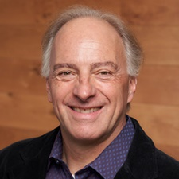
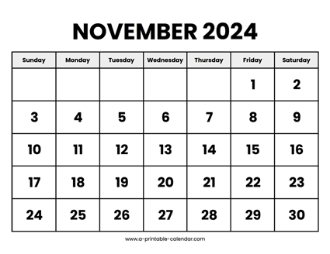

CS 310 : Scalable Software Architectures
Class session on Tuesday, November 5th
Notes:
Focus this week:
Serverless, API Gateway + lambda, Docker
Project 03 was released
Serverless, event-driven PDF analysis
Due Friday November 15th

Slide 2
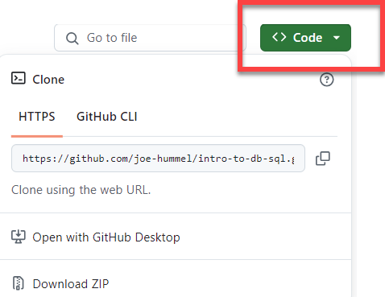
Getting the necessary software
Make sure Docker Desktop is running
Download files you need for today
https://github.com/joe-hummel/serverless-demo
Open a terminal window, navigate to repo:
Linux/Mac/Windows WSL:
Open terminal, navigate to repo folder
chmod 755 *.bash
./docker-build.bash
./docker-run.bash
Windows:
Open Powershell, navigate to repo folder
.\docker-build.bat
.\docker-run.bat

Slide 3
Common docker errors
"docker" command not found
Uninstall and reinstall Docker Desktop
When you try to build, you are not authorized
docker login -u docker-username
When you try to run, you get errors like "bash: $\r: command not found"
If you see the docker> prompt, type exit
((Get-Content .bashrc) -join "`n") + "`n" | Set-Content -NoNewLine .bashrc

Slide 4
New architectural concepts…
Introducing three design concepts…
Event-driven design
Serverless computing
Asynchronous APIs

Slide 5
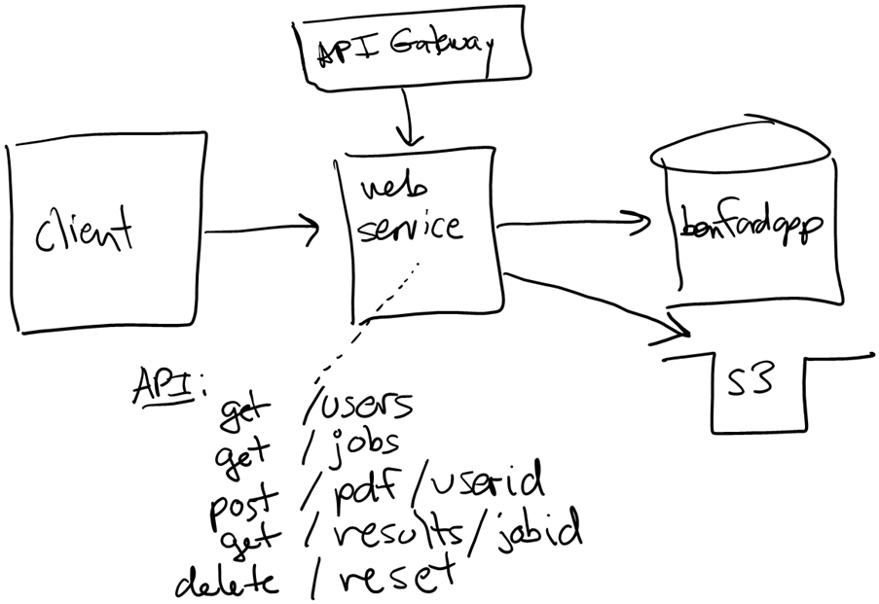
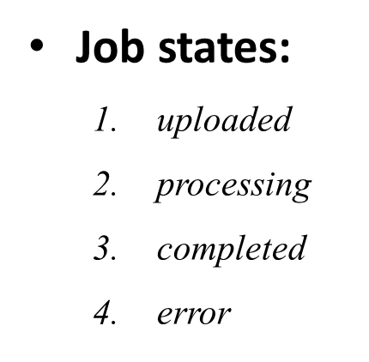
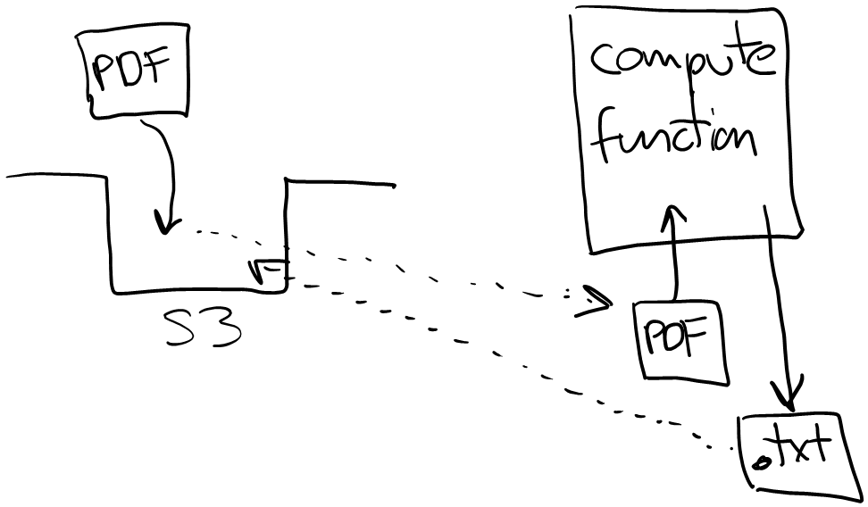
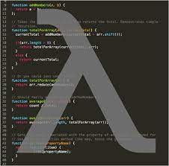
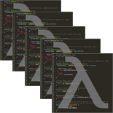
Project 03
Project 03 uses a different architectural approach:
Event-driven
Serverless
Asynchronous API

Slide 6
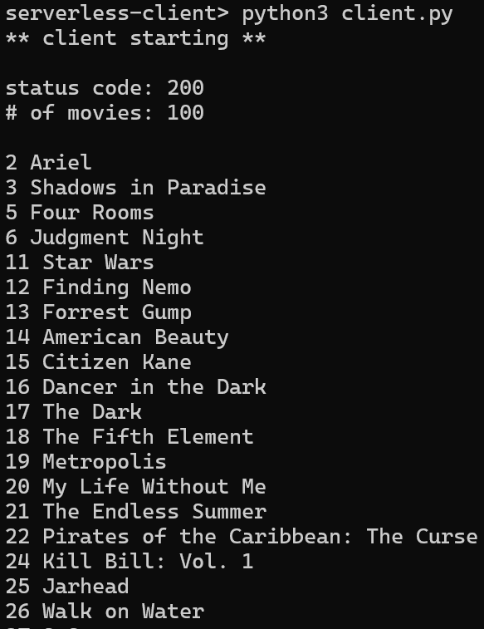
Serverless demo
Let’s build web service to access MovieLens DB using API Gateway and lambda…

Slide 7
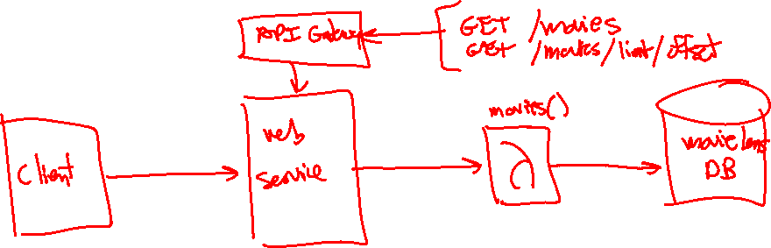
Serverless demo
Let’s build web service to access MovieLens DB using API Gateway and lambda…

Slide 8
Steps
Write Lambda function, test – missing module…
Package import(s) as layer, configure, test
Configure API Gateway, test
Client-side test: browser / postman
Client-side app

Slide 9
That's it, thank you!

